Slide 1




____________________________________________________________________________
____________________________________________________________________________
DATA SCIENCE & MACHINE LEARNING
Introduction Course
(23 JAN - 01 March 2019)
Coordination Team:
Augusto Albuquerque (ISCTE-IUL)
Inês Cortez Esteves (Deloitte)
Pedro Sebastião (ISCTE-IUL/AUDAX-ISCTE)
Pedro Tavares (Deloitte)
Team:
António Raimundo (ISCTE-IUL)
Dária Baikova (ISCTE-IUL)
João Oliveira (ISCTE-IUL)
Ricardo Ribeiro (ISCTE-IUL)
Sérgio Moro (ISCTE-IUL)
(Jan.-Mar. 2019) DATA SCIENCE & MACHINE LEARNING – Introduction Course Page 1

Slide 2
____________________________________________________________________________
____________________________________________________________________________
DATA SCIENCE & MACHINE LEARNING
Introduction Course
General Contents (23 JAN 2019)
#0 Introduction – Overview (23 JAN 2019)
#1 IPython – Beyond Normal Python (23 JAN 2019)
#2 Introduction to NumPy
#3 Data Manipulation and Visualization
#4 Statistical Analysis
#5 Time-Series and High Perfomance Pandas
#6 Introduction to Machine Leaning
#7 Machine Learning Techniques
#8 Deep Learning
#9 Network Analysis Social Networks
#10 Recommendation Systems using NLP
(Jan.-Mar. 2019) DATA SCIENCE & MACHINE LEARNING – Introduction Course Page 2

Slide 3
____________________________________________________________________________
____________________________________________________________________________
DATA SCIENCE & MACHINE LEARNING
#0 Introduction – Overview
(23 JAN 2019)
Lecturers: Sérgio Moro & António Raimundo
(Jan.-Mar. 2019) DATA SCIENCE & MACHINE LEARNING – Introduction Course Page 3

Slide 4
____________________________________________________________________________
____________________________________________________________________________
#0 Introduction – Overview
Contents (23 JAN 2019)
Introduction to Data Science
CRISP-DM
Practical example: CRM
Practical example: Service Desk System
(Jan.-Mar. 2019) DATA SCIENCE & MACHINE LEARNING – Introduction Course Page 4

Slide 5
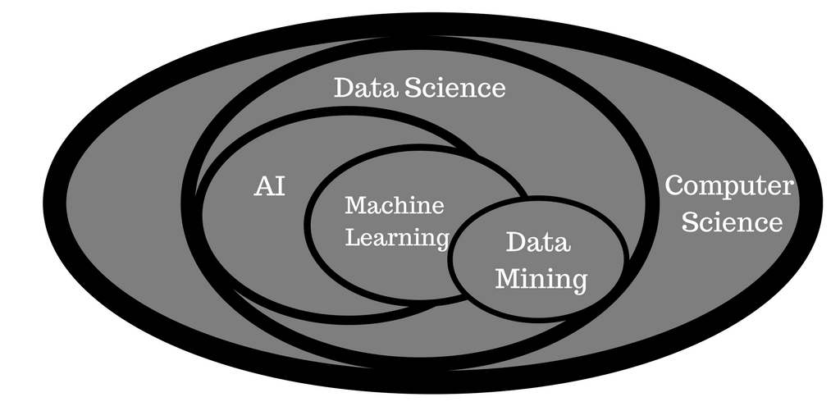
What is Data Science? Interdisciplinary data-driven approach to address problems for which there is available data.
____________________________________________________________________________
#0 Introduction – Overview
____________________________________________________________________________
(Jan.-Mar. 2019) DATA SCIENCE & MACHINE LEARNING – Introduction Course Page 5

Slide 6
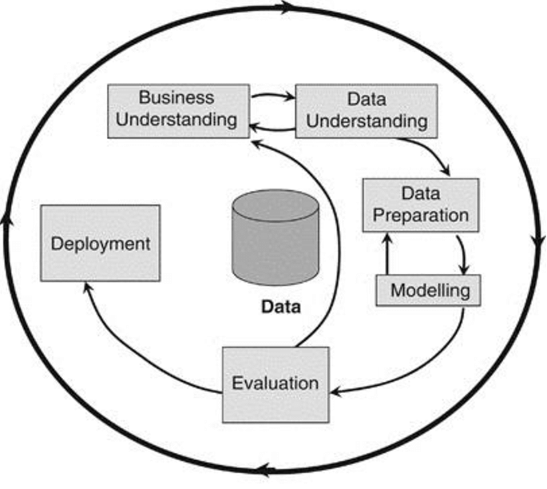
Data Mining: knowledge discovery process that aims to unveil insightful patterns from raw data (it is encompassed within Data Science) Text Mining: Unstructured data
____________________________________________________________________________
#0 Introduction – Overview
____________________________________________________________________________
Data Mining CRISP-DM Methodology
Note: Machine Learning (ML) aims to learn from data.
Thus, ML may (and it is often) used for building models within a DM project.
(Jan.-Mar. 2019) DATA SCIENCE & MACHINE LEARNING – Introduction Course Page 6

Slide 7
____________________________________________________________________________
#0 Introduction – Overview
____________________________________________________________________________
Data Mining CRISP-DM Methodology
Business Understanding
Hear from business experts:
How do they define the problem?
What are the factors that may influence the result?
How would they measure the success of a possible solution?
Create a project
Goals
Risks
Stakeholders
Plan
(Jan.-Mar. 2019) DATA SCIENCE & MACHINE LEARNING – Introduction Course Page 7

Slide 8
____________________________________________________________________________
#0 Introduction – Overview
____________________________________________________________________________
Data Mining CRISP-DM Methodology
Data Understanding
What are the variables that best characterize the problem (input variables)? What is their range of possible values and type (e.g., categorical vs. numeric)?
From these, which best translate the business goal (for supervised learning)?
Are there data quality issues?
Inconsistent data originated in more than one source
Missing values
(Jan.-Mar. 2019) DATA SCIENCE & MACHINE LEARNING – Introduction Course Page 8

Slide 9
____________________________________________________________________________
#0 Introduction – Overview
____________________________________________________________________________
Data Mining CRISP-DM Methodology
Data Preparation
Data integration: consolidate data from distinct sources
Feature selection: which input variables?
Feature Engineering: computing new interesting variables
Data cleaning: deal with missing values, outliers
(Jan.-Mar. 2019) DATA SCIENCE & MACHINE LEARNING – Introduction Course Page 9

Slide 10
____________________________________________________________________________
#0 Introduction – Overview
____________________________________________________________________________
Data Mining CRISP-DM Methodology
Modeling
Uses Statistics or Machine Learning algorithms to train a model
It depends on the goal:
Unsupervised learning – find relations between input variables
Supervised learning – use a target (dependent) variable to build a model based on input variables
If the target is categorical (e.g., grant loan: Y/N), then it is a classification problem; else (for numeric variables, e.g., how many products sold), it is a regression problem
(Jan.-Mar. 2019) DATA SCIENCE & MACHINE LEARNING – Introduction Course Page 10

Slide 11
____________________________________________________________________________
#0 Introduction – Overview
____________________________________________________________________________
Data Mining CRISP-DM Methodology
Evaluation
Assess if the model is accurate
For supervised learning models: how close are the predictions from the real values?
For unsupervised learning: how consistent are the identified groups?
In a production scenario: a model is trained using past data, and it is evaluated using future data
During project (or for a quick model tuning): partition the dataset into train (to build the model )and test sets
(Jan.-Mar. 2019) DATA SCIENCE & MACHINE LEARNING – Introduction Course Page 11

Slide 12
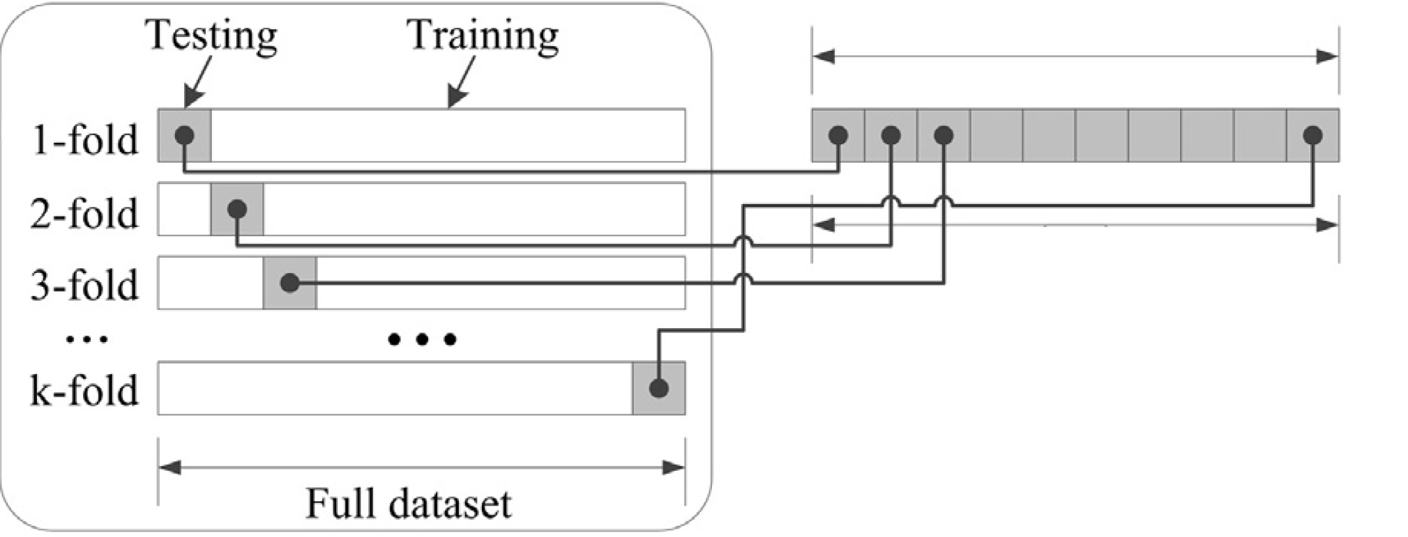
____________________________________________________________________________
#0 Introduction – Overview
____________________________________________________________________________
Data Mining CRISP-DM Methodology
Evaluation
K-fold cross validation: each fold is used once for testing and K-1 times for training
(Jan.-Mar. 2019) DATA SCIENCE & MACHINE LEARNING – Introduction Course Page 12

Slide 13
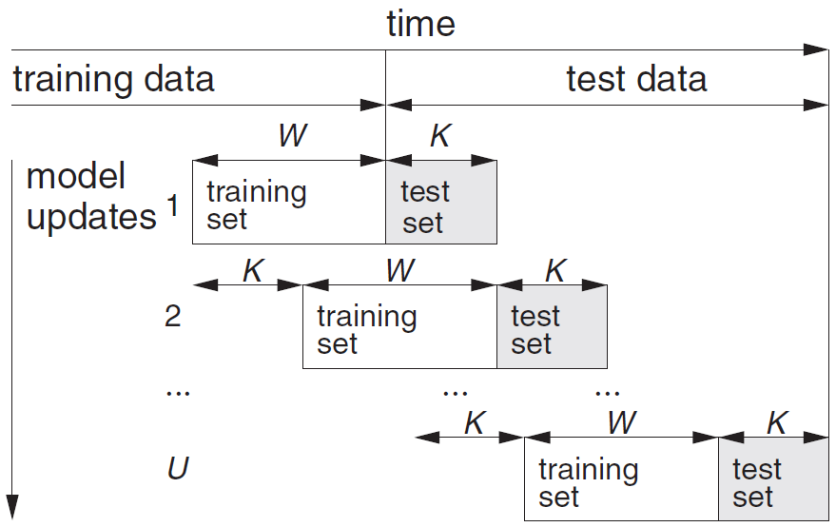
____________________________________________________________________________
#0 Introduction – Overview
____________________________________________________________________________
Data Mining CRISP-DM Methodology
Evaluation
Rolling Windows: to simulate a periodic train/test scenario
All occurrences of the problem (also called instances) must be sorted by date
This is what will happen once the model is deployed into production
(Jan.-Mar. 2019) DATA SCIENCE & MACHINE LEARNING – Introduction Course Page 13

Slide 14
____________________________________________________________________________
#0 Introduction – Overview
____________________________________________________________________________
Data Mining CRISP-DM Methodology
Deployment
Install the model into a production environment
Yet, the work isn’t over:
Real problems are dynamic and the model’s performance can quickly deteriorate
New variables may need to be incorporated, or some removed
Out-of-the-ordinary events may induce unexpected behavior
Thus, tuning should be done periodically
CRISP-DM is a cyclic methodology that
advocates revision iterations
(Jan.-Mar. 2019) DATA SCIENCE & MACHINE LEARNING – Introduction Course Page 14

Slide 15
____________________________________________________________________________
#0 Introduction – Overview
____________________________________________________________________________
Data Mining CRISP-DM Methodology
Deployment
Install the model into a production environment
Yet, the work isn’t over:
Real problems are dynamic and the model’s performance can quickly deteriorate
New variables may need to be incorporated, or some removed
Out-of-the-ordinary events may induce unexpected behavior
Thus, tuning should be done periodically
CRISP-DM is a cyclic methodology that
advocates revision iterations
(Jan.-Mar. 2019) DATA SCIENCE & MACHINE LEARNING – Introduction Course Page 15

Slide 16

____________________________________________________________________________
#0 Introduction – Overview
____________________________________________________________________________
Customer Relationship Management (CRM)
Back Office
Analytical CRM
Front Office
Operational CRM
Usual questions:
Which customers to contact?
Which products to sell?
CRM Data
Usual operations:
Contact customer
Sell product
Customer
(Jan.-Mar. 2019) DATA SCIENCE & MACHINE LEARNING – Introduction Course Page 16

Slide 17
____________________________________________________________________________
#0 Introduction – Overview
____________________________________________________________________________
Customer Relationship Management (CRM)
Back Office
Analytical CRM
Front Office
Operational CRM
How to answer usual questions:
Through implemented Data Mining models
CRM Data
How to make usual operations:
Through operational applications (e.g., contact center)
Customer
(Jan.-Mar. 2019) DATA SCIENCE & MACHINE LEARNING – Introduction Course Page 17

Slide 18
____________________________________________________________________________
#0 Introduction – Overview
____________________________________________________________________________
Customer Relationship Management (CRM)
Which customers to contact for selling a product?
Back Office
Analytical CRM
Front Office
Operational CRM
Operational CRM DB
Contact Center
EDW
Customer
Data Mining
Customer Datamart
(Jan.-Mar. 2019) DATA SCIENCE & MACHINE LEARNING – Introduction Course Page 18
Notes:
Supervised learning: probability that the customer buys the product that is being offered.

Slide 19
____________________________________________________________________________
#0 Introduction – Overview
____________________________________________________________________________
Customer Relationship Management (CRM)
Closing the loop…
Back Office
Analytical CRM
Front Office
Operational CRM
ETL
1 - get updated information to retrain the model
2 - save model’s predictions
Operational CRM DB
4
Contact Center
EDW
3
Customer
Data Mining
1
Customer Datamart
3 - get information on the customer to contact
4 - save the result of contacting the customer
2
(Jan.-Mar. 2019) DATA SCIENCE & MACHINE LEARNING – Introduction Course Page 19

Slide 20
____________________________________________________________________________
#0 Introduction – Overview
____________________________________________________________________________
Customer Relationship Management (CRM)
Which customers to contact for selling a product?
Back Office
Analytical CRM
Front Office
Operational CRM
ETL
(*) This is why it is so important to keep updating the model: to tune it and adapt it to changing scenarios
Operational CRM DB
Contact Center
EDW
Customer
Data Mining
Customer Datamart
* If the DM model suggested to contact a customer, but the customer didn’t buy it, then the model mispredicted it!
(Jan.-Mar. 2019) DATA SCIENCE & MACHINE LEARNING – Introduction Course Page 20

Slide 21
____________________________________________________________________________
#0 Introduction – Overview
____________________________________________________________________________
Service Desk System (SD)
Incident management
Back Office
Front Office
Usual questions:
How to categorize incoming incidents (to prioritize them)?
How to diagnose to suggest a solution?
Usual operations:
Categorize (or revise priority of) incidents
Propose a solution to the problem
Escalate to specialized staff
SD Data
Customer
(Jan.-Mar. 2019) DATA SCIENCE & MACHINE LEARNING – Introduction Course Page 21

Slide 22
____________________________________________________________________________
#0 Introduction – Overview
____________________________________________________________________________
Service Desk System (SD)
Incident management – Automatic categorization
Back Office
Front Office
ETL
Staff may reprioritize based on reassessment
EDW
Staff may reprioritize on customer request
SD
DB
Customer
Data Mining
Incident Datamart
In this case, we want immediate categorization (mandatory for critical incidents)
Train model
Categorize/prioritize incidents as these arrive
Deploy model
Model
(Jan.-Mar. 2019) DATA SCIENCE & MACHINE LEARNING – Introduction Course Page 22
Notes:
Unsupervised learning: clusters of distinct categories of incidents

Slide 23
____________________________________________________________________________
____________________________________________________________________________
THANK YOU FOR YOUR PARTICIPATION
#0 Introduction – Overview
(23 JAN 2019)
Next module is:
#1 IPython – Beyond Normal Python
(23 JAN 2019)
(Jan.-Mar. 2019) DATA SCIENCE & MACHINE LEARNING – Introduction Course Page 23

Slide 24
____________________________________________________________________________
____________________________________________________________________________
DATA SCIENCE & MACHINE LEARNING
#1 IPython – Beyond Normal Python
(23 JAN 2019)
Lecturers: Sérgio Moro & António Raimundo
(Jan.-Mar. 2019) DATA SCIENCE & MACHINE LEARNING – Introduction Course Page 24

Slide 25
____________________________________________________________________________
____________________________________________________________________________
#1 IPython – Beyond Normal Python
Contents (23 JAN 2019)
Shell or Notebook
Help and Documentation in IPython
Magic Commands
Input and Output History
Notebook and Shell Commands
Errors and Debugging
Profiling and Timing Code
(Jan.-Mar. 2019) DATA SCIENCE & MACHINE LEARNING – Introduction Course Page 25

Slide 26
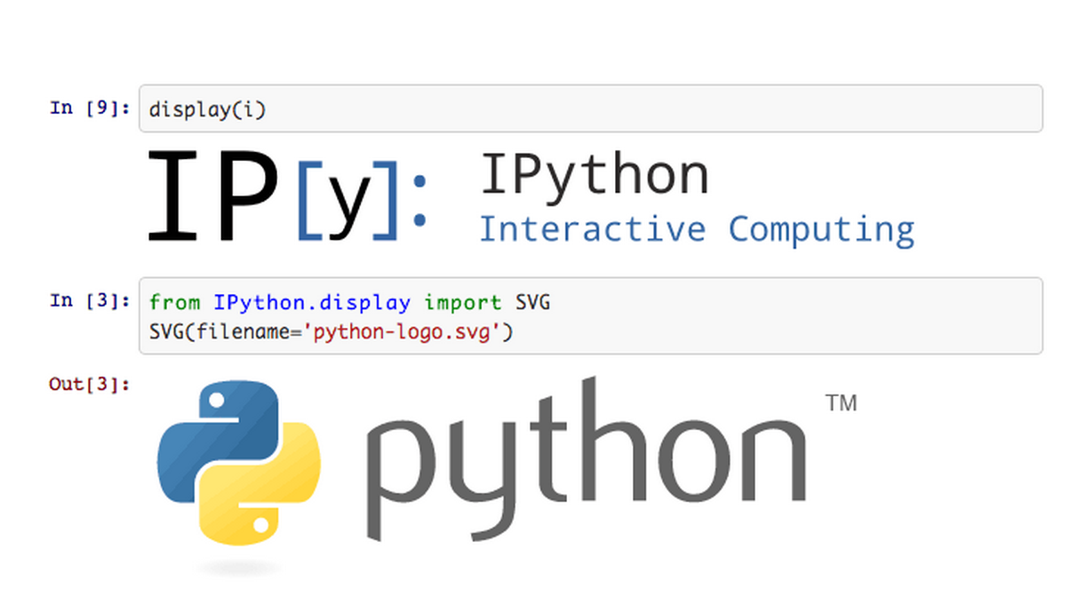
____________________________________________________________________________
#1 IPython – Beyond Normal Python
____________________________________________________________________________
What is IPython?
Features
Ties with Jupyter project
Notebook
Shell or Notebook?
We will work all the code examples on Jupyter Notebook!
(Jan.-Mar. 2019) DATA SCIENCE & MACHINE LEARNING – Introduction Course Page 26
Notes:
What is IPython?
IPython (short for Interactive Python) was started in 2001 by Fernando Perez as an enhanced Python interpreter, and has since grown into a project aiming to provide tools for the entire life cycle of research computing. If Python is the engine of our data science task, you might think of IPython as the interactive control panel. As well as being a useful interactive interface to Python, IPython also provides a number of useful syntactic additions to the language; we'll cover the most useful of these additions here. IPython is about using Python effectively for interactive scientific and data-intensive computing. This module will start by stepping through some of the IPython features that are useful to the practice of data science, focusing especially on the syntax it offers beyond the standard features of Python. Next, we will go into a bit more depth on some of the more useful "magic commands" that can speed-up common tasks in creating and using data science code. Finally, we will touch on some of the features of the notebook that make it useful in understanding data and sharing results.
Ties with Jupyter project
In addition, IPython is closely tied with the Jupyter project, which provides a browser-based notebook that is useful for development, collaboration, sharing, and even publication of data science results. The IPython notebook is actually a special case of the broader Jupyter notebook structure, which encompasses notebooks for Julia, R, and other programming languages.
Shell or Notebook?
There are two primary means of using IPython: Shell and Notebook. The bulk of the material in this module will be ran on Jupyter Notebook. So, and before we start, I will show you what is Jupyter Notebook and how to launch it.

Slide 27

____________________________________________________________________________
#1 IPython – Beyond Normal Python
____________________________________________________________________________
Jupyter Notebook
(Jan.-Mar. 2019) DATA SCIENCE & MACHINE LEARNING – Introduction Course Page 27
Notes:
Jupyter Notebook
The Jupyter notebook is a browser-based graphical interface to the IPython shell, and builds on it a rich set of dynamic display capabilities. As well as executing Python/IPython statements, the notebook allows the user to include formatted text, static and dynamic visualizations, mathematical equations, JavaScript widgets, and much more. Furthermore, these documents can be saved in a way that lets other people open them and execute the code on their own systems.
Though the IPython notebook is viewed and edited through your web browser window, it must connect to a running Python process in order to execute code. This process (known as a "kernel") can be started by running the following command in your system shell.

Slide 28
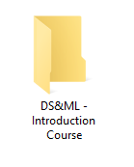

____________________________________________________________________________
#1 IPython – Beyond Normal Python
____________________________________________________________________________
Launch Jupyter Notebook
Create a folder on a desired location on your PC named: “DS&ML – Introduction Course”
Create a subfolder called “Module 1”
You can create subfolders later for each module, according to the ongoing lectured module (2,3,4 and so on)
(Windows users)
Enter “Module 1” folder, and type “cmd” on ‘current location’ bar
On the command line terminal, type: ‘jupyter notebook’
(Linux/MacOS users)
Open Terminal and type: ‘jupyter notebook’
Navigate to “Module 1” folder using Notebook’s explorer interface.
(Jan.-Mar. 2019) DATA SCIENCE & MACHINE LEARNING – Introduction Course Page 28
Notes:
Launch Jupyter Notebook
This command will launch a local web server that will be visible to your browser. It immediately spits out a log showing what it is doing; that log will look something like this:
Use Control-C to stop this server and shut down all kernels (twice to skip confirmation). Upon issuing the command, your default browser should automatically open and navigate to the listed local URL; the exact address will depend on your system. If the browser does not open automatically, you can open a window and manually open this address (http://localhost:8888/ in this example).

Slide 29
____________________________________________________________________________
#1 IPython – Beyond Normal Python
____________________________________________________________________________
#1.1 Help and Documentation in IPython
Accessing Documentation with ‘?’
Accessing Source Code with ‘??’
Exploring Modules with Tab-Completion
Tab-completion of object contents
Tab completion when importing
(Jan.-Mar. 2019) DATA SCIENCE & MACHINE LEARNING – Introduction Course Page 29
Notes:
What is IPython?
IPython (short for Interactive Python) was started in 2001 by Fernando Perez as an enhanced Python interpreter, and has since grown into a project aiming to provide tools for the entire life cycle of research computing. If Python is the engine of our data science task, you might think of IPython as the interactive control panel. As well as being a useful interactive interface to Python, IPython also provides a number of useful syntactic additions to the language; we'll cover the most useful of these additions here. IPython is about using Python effectively for interactive scientific and data-intensive computing. This module will start by stepping through some of the IPython features that are useful to the practice of data science, focusing especially on the syntax it offers beyond the standard features of Python. Next, we will go into a bit more depth on some of the more useful "magic commands" that can speed-up common tasks in creating and using data science code. Finally, we will touch on some of the features of the notebook that make it useful in understanding data and sharing results.
Ties with Jupyter project
In addition, IPython is closely tied with the Jupyter project, which provides a browser-based notebook that is useful for development, collaboration, sharing, and even publication of data science results. The IPython notebook is actually a special case of the broader Jupyter notebook structure, which encompasses notebooks for Julia, R, and other programming languages.
Shell or Notebook?
There are two primary means of using IPython: Shell and Notebook. The bulk of the material in this module will be ran on Jupyter Notebook. So, and before we start, I will show you what is Jupyter Notebook and how to launch it.

Slide 30
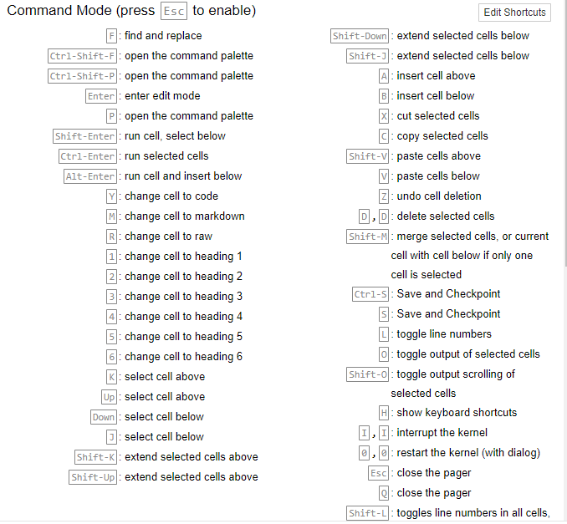
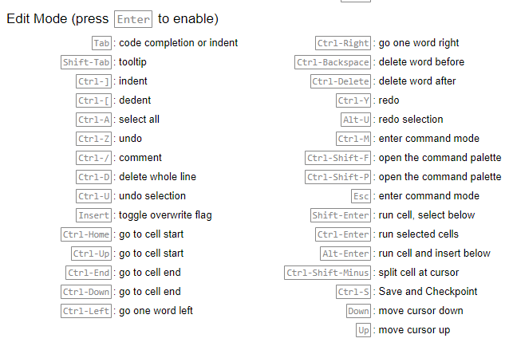
____________________________________________________________________________
#1 IPython – Beyond Normal Python
____________________________________________________________________________
#1.2 Keyboard Shortcuts
Interactive Demonstration
(Jan.-Mar. 2019) DATA SCIENCE & MACHINE LEARNING – Introduction Course Page 30

Slide 31

____________________________________________________________________________
#1 IPython – Beyond Normal Python
____________________________________________________________________________
#1.3 Notebook’s Magic Commands
Run external code: %run
Create a file named ‘script1.py’ with the following content (continue on Notebook)
General description of magic commands: %magic
List all available magic commands: %lsmagic
(Jan.-Mar. 2019) DATA SCIENCE & MACHINE LEARNING – Introduction Course Page 31

Slide 32
____________________________________________________________________________
#1 IPython – Beyond Normal Python
____________________________________________________________________________
#1.4 Input and Output History
Notebook’s In and Out objects
Underscore Shortcuts and Previous Outputs
Suppressing Output
Related Magic Commands
(Jan.-Mar. 2019) DATA SCIENCE & MACHINE LEARNING – Introduction Course Page 32

Slide 33
____________________________________________________________________________
#1 IPython – Beyond Normal Python
____________________________________________________________________________
#1.5 Notebook and Shell Commands
Shell Commands
Shell Commands in Jupyter Notebook
Passing values to and from Shell
(Jan.-Mar. 2019) DATA SCIENCE & MACHINE LEARNING – Introduction Course Page 33

Slide 34
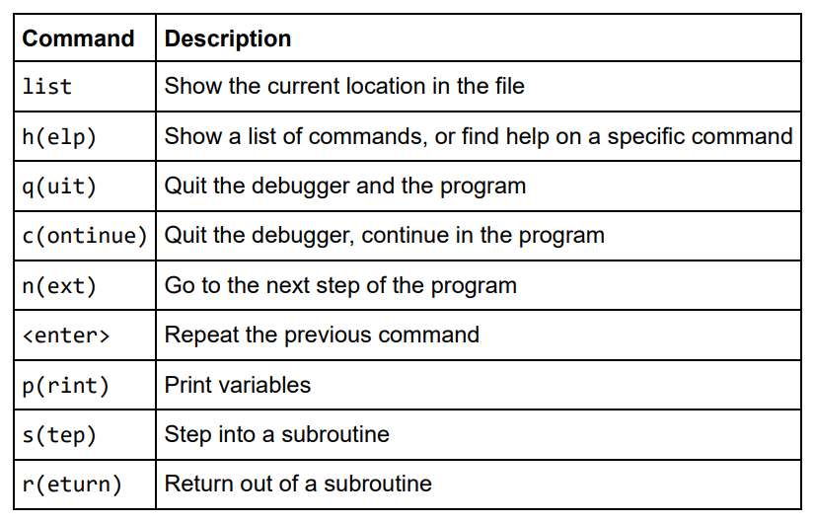
____________________________________________________________________________
#1 IPython – Beyond Normal Python
____________________________________________________________________________
#1.6 Errors and Debugging
Controlling Exceptions: %xmode
Debug mode
Partial list of debugging commands
(Jan.-Mar. 2019) DATA SCIENCE & MACHINE LEARNING – Introduction Course Page 34

Slide 35
____________________________________________________________________________
#1 IPython – Beyond Normal Python
____________________________________________________________________________
#1.7 Profiling and Timing Code
Timing Code Snippets: %timeit and %time
Profiling Full Scripts: %prun
Line-by-Line Profiling: %lprun
Install Line Profiler using ‘pip’:
‘pip install line_profiler’
Profiling Memory Use: %memit and %mprun
Install Memory Profiler using ‘pip’:
‘pip install memory_profiler’
(Jan.-Mar. 2019) DATA SCIENCE & MACHINE LEARNING – Introduction Course Page 35

Slide 36
____________________________________________________________________________
____________________________________________________________________________
THANK YOU FOR YOUR PARTICIPATION
#1 IPython – Beyond Normal Python
(23 JAN 2019)
Next module is:
#2 Introduction to NumPy
(25 JAN 2019)
(Jan.-Mar. 2019) DATA SCIENCE & MACHINE LEARNING – Introduction Course Page 36

